Slide 1

Project timeline (Phase 1)
Phase 1: Planning Tasks:
Define project scope and goals
Identify target audience and research market trends
Create project roadmap and timeline
Establish communication plan and project management tools
Assign roles and responsibilities to team members

Slide 2

Project timeline (Phase 2)
Phase 2: Design.
Develop game concept and design documents
Create flowchart/game flow diagram
Design user interface and game art assets
Finalize game mechanics and gameplay features
Review and obtain feedback if applicable

Slide 3
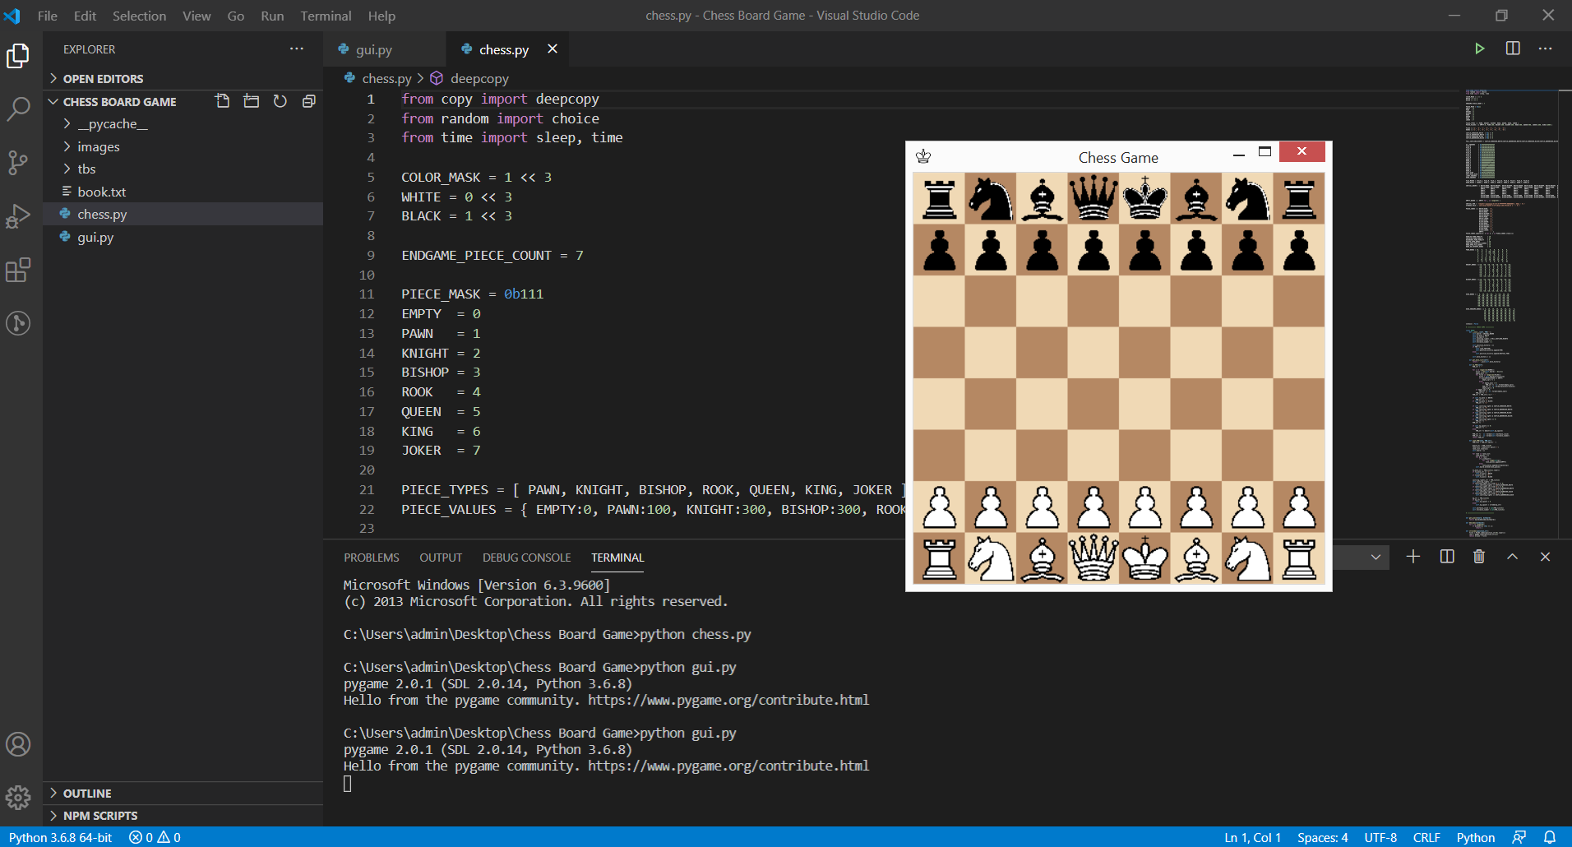
Project timeline (Phase 3)
Phase 3: Development
Set up development environment and tools
Implement game mechanics and gameplay features
Develop multiplayer capabilities if time permits
Integrate art assets, sound effects, and music
Conduct quality assurance and testing
Debug and optimize game performance

Slide 4

Project timeline (Phase 4)
Phase 3: Deployment
Conduct final quality assurance testing and debugging
Release the game
Provide post-release support and updates if applicable

Slide 5
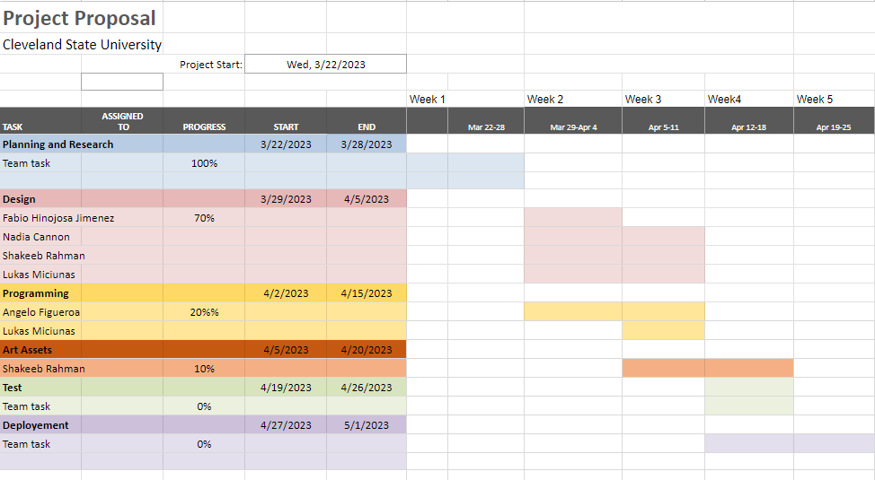
Gantt Chart

